Slide 1
Patent Data-Set Project Data Analytics using Python (Submitted to NEILIT HARIDWAR) Course Co-Ordinator: Kailash Joshi
Submitted to NEILIT HARIDWAR
Submitted By: Gaurav Jagdev
gjagdev19@gmail.com
+91-9876071669

Slide 2
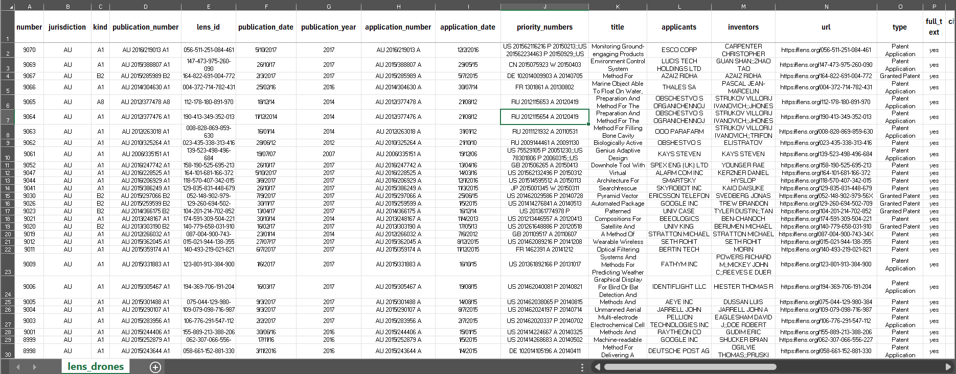
Data-set for drone technology
lens_drones – A full spectrum of scientific & patent publications from the Lens open access database. The dataset contains invention details like application, published, priority dates, origin & filing jurisdictions, title, inventors etc.
Each row is a observation or sample and each column is variable or measurement

Slide 3
Project Objective for patent dataset
Calculate duration from application to publication by patent type.
Visualize jurisdiction and origin country patterns.
Build KNN models to predict duration and jurisdiction.
Provide a simple GUI to query predictions.

Slide 4
Scope of Work
Load and clean Lens dataset.
Extract origin country from priority numbers.
Balanced sampling by type and country.
Compute durations and average by type.
Visualize results (line and scatter).
Train KNN models and expose predictions via Tkinter.

Slide 5
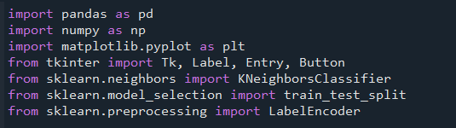
Tools and Technology
Anacoda & Spyder : Distributor and Integrated Development Environment (IDE)
Python: pandas, numpy, matplotlib
scikit‑learn: KNeighborsClassifier, train_test_split, LabelEncoder
Tkinter: simple GUI and message boxes for predictions

Slide 6
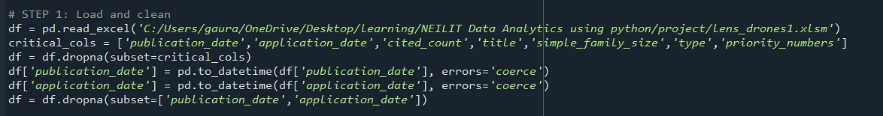
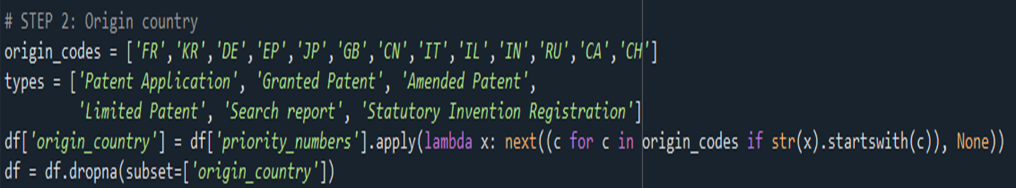
Import and Data Cleaning
Define and Extract variables from columns

Slide 7
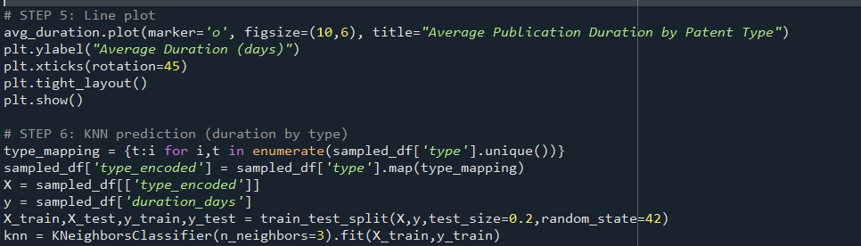
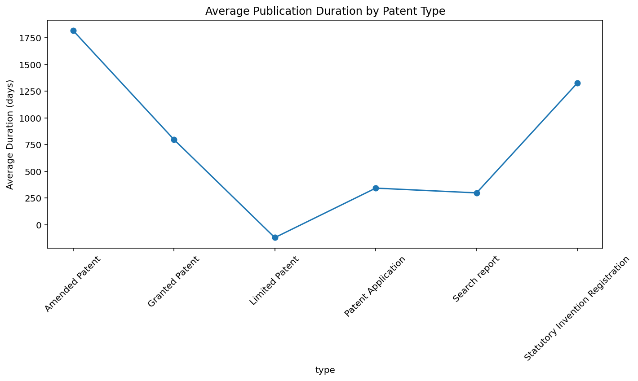
Sample observation and Duration
Average Duration Line plot by application type

Slide 8
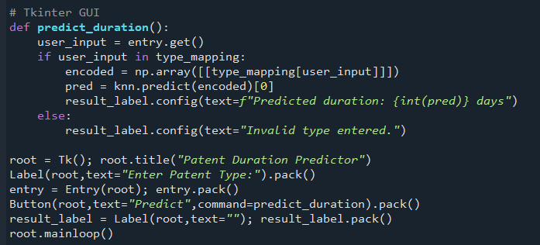
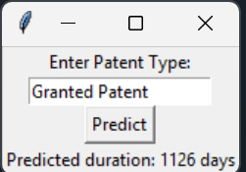
Tkinter GUI for userinput to predict duration

Slide 9
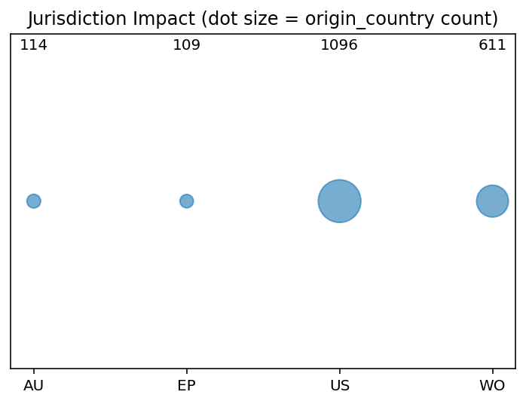
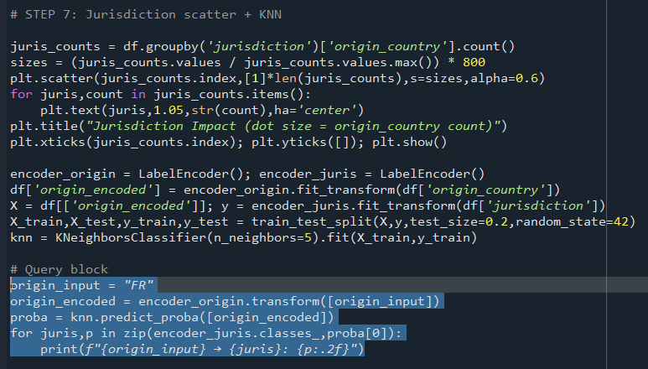


Jurisdiction Classification Plot and Prediction

Slide 10
Result
Conclusion
Data Preparation: Dataset cleaned, dates standardized, and origin countries extracted.
Duration Analysis: Publication delays vary by type.
Visualization: Line plot shows duration differences; scatter plot highlights dominant jurisdictions (US, WO).
Sampling: Sample Observation ensured fair and targeted representation.
Interactive GUI: Tkinter interface allows quick user input and instant prediction display.
Prediction Models:
KNN Duration: Patent type predicts approximate publication duration;
KNN Jurisdiction: Origin country mapped to jurisdiction probabilities (e.g., FR → US: 0.60, AU: 0.20).
The project demonstrates how basic analytics and machine learning can extract meaningful insights from open patent data.
Visualization (line and scatter plots) shows trends and classification inference
Prediction models (KNN-Classifier) provide quick and interpretable estimates.

